Slide 1

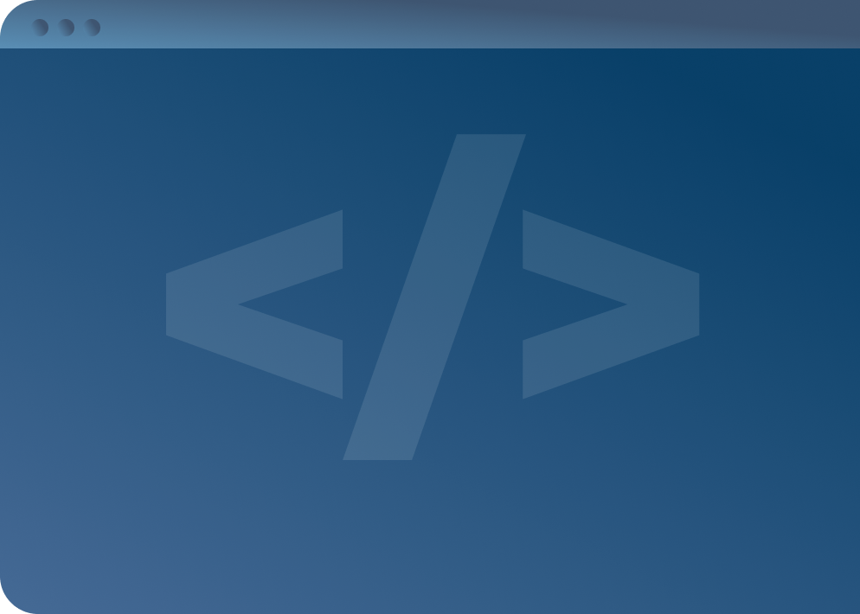

SOFTWARE DEVELOPMENT PROFESSIONAL PROGRAM
Arrays & Iteration

Slide 2





Arrays & Iteration
Learning Objectives
Define iteration.
List the three clauses of a for loop.
Iterate over an array using a for loop.

Slide 3

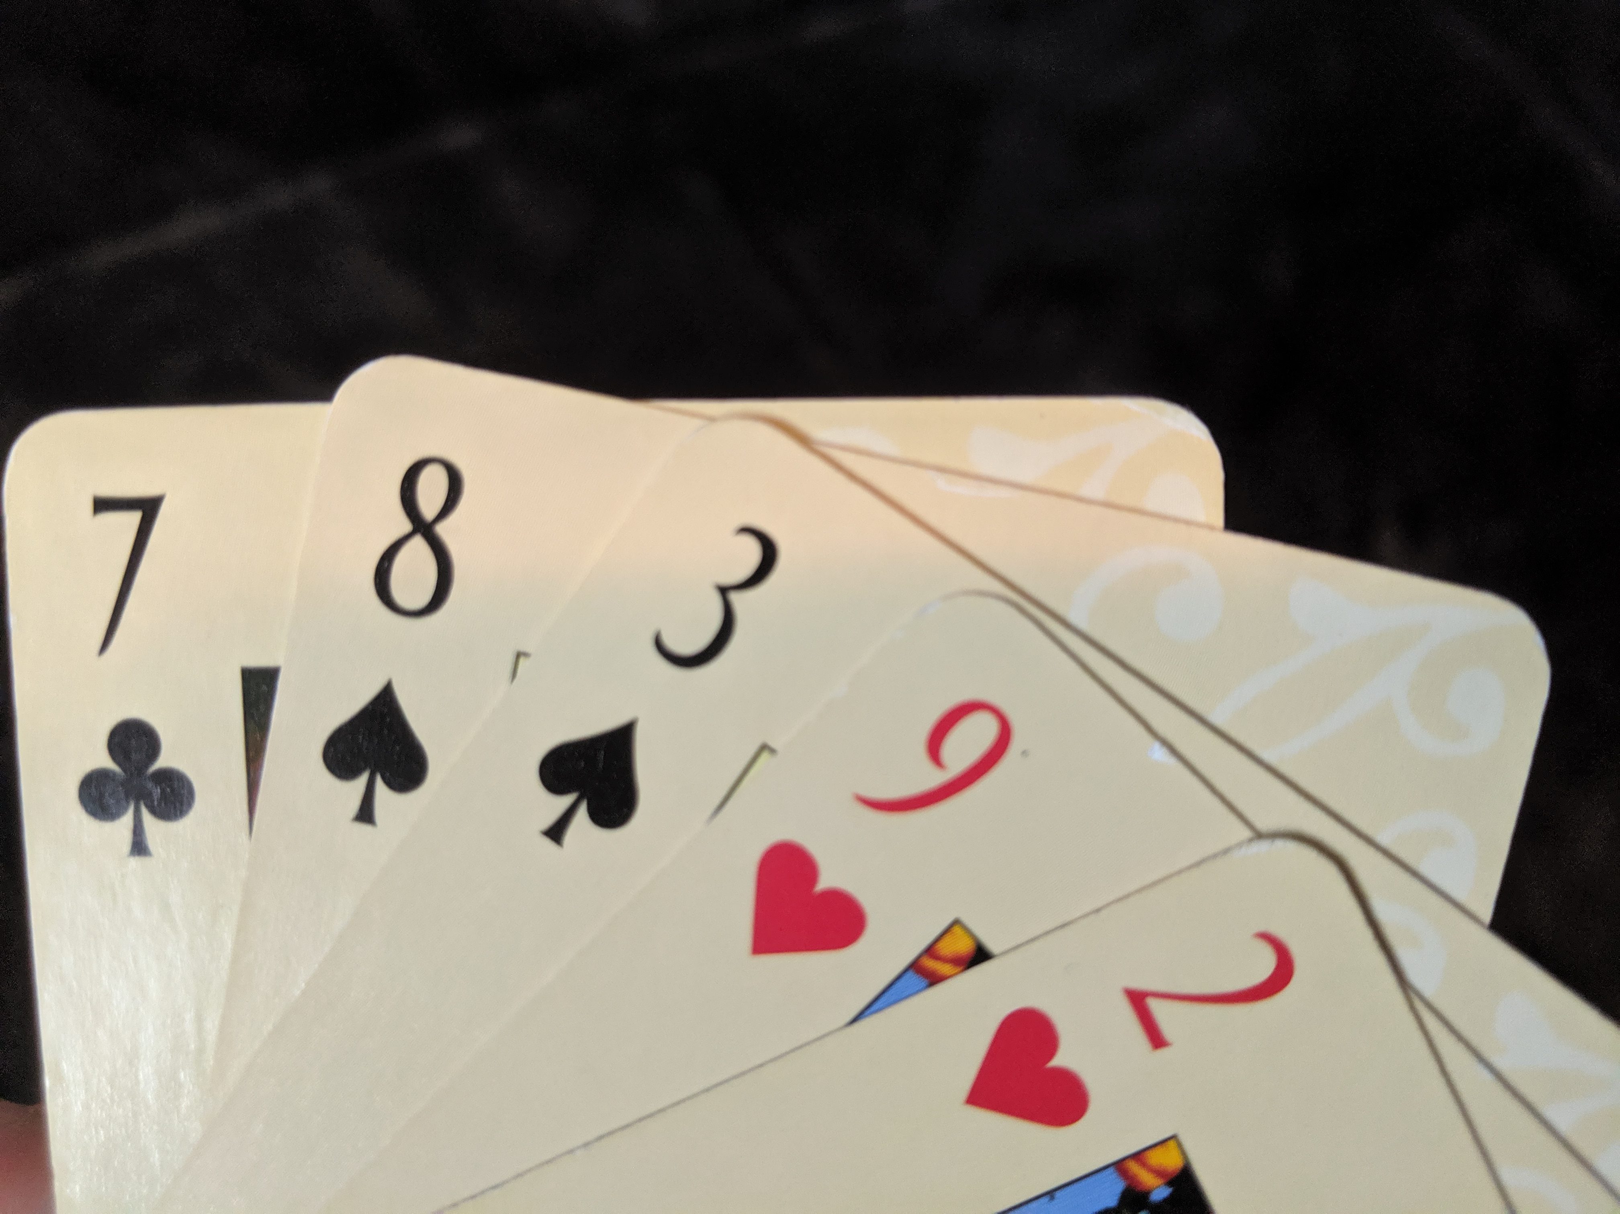
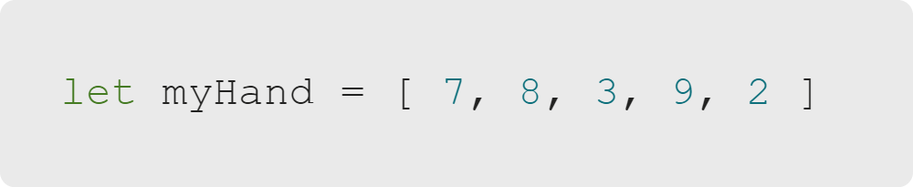
Arrays & Iteration
Cards
What is the highest-numbered card in this hand?
Notes:
How did you figure out that nine is the highest-numbered card?

Slide 4
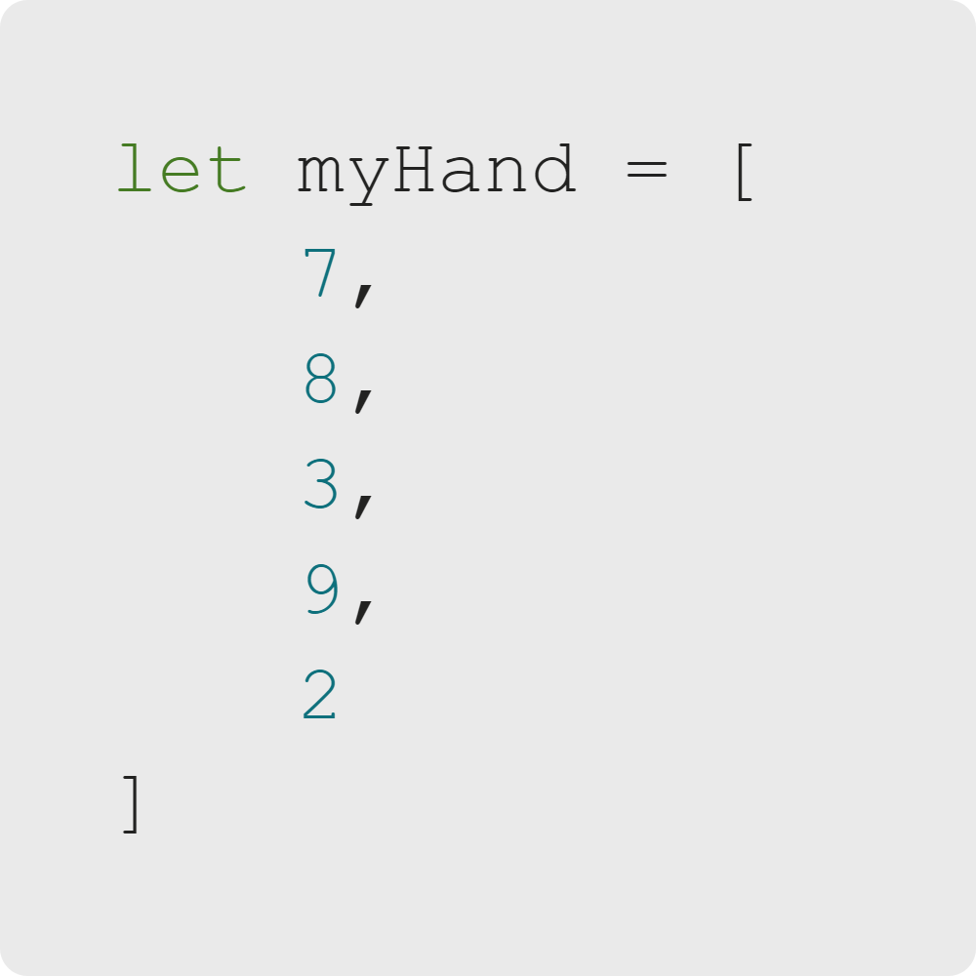
Arrays & Iteration
Cards
Start at the first card.
Compare it to the next card.
Keep the highest.
Repeat the process starting at step 2.
Notes:
Most of us probably went through this process, even if we went through it very quickly.

Slide 5

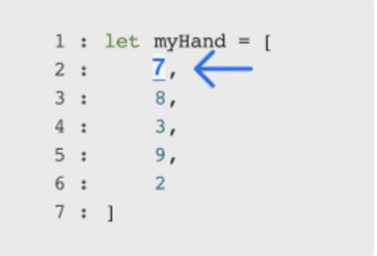
Arrays & Iteration
Iteration
Iteration
Repeating a process (lines of code)
Helpful for processing every element in an array
Notes:
When we iterate over an array, we are repeating a process for each item in the array.
What process are we repeating in this example?
<<Exercise 01--what is iteration?>>

Slide 6

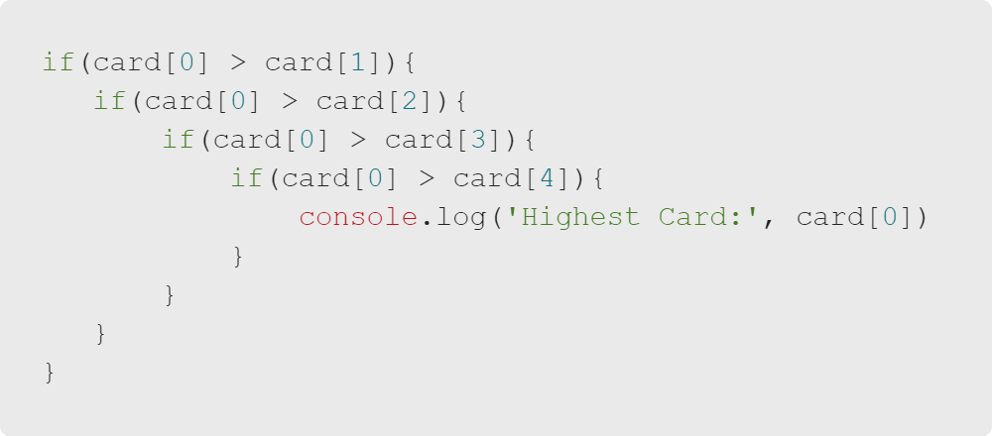
Arrays & Iteration
Power of Iteration
Without Iteration
(Don't ever do this.)
Notes:
This code only works if the highest card is the first in the array, so we would need to have
many more conditional statements to go through the whole array.
If we know the number of elements in an array, we can always solve array-centric problems with
repetitious code.
However, iteration lets us solve array-centric problems for arrays of *any* length.

Slide 7
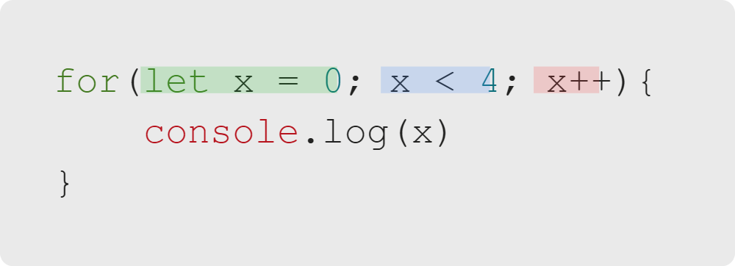
Arrays & Iteration
Anatomy of a For Loop
For loops have three clauses:
Initializer
Condition
Afterthought
Notes:
Our code can iterate with for loops.
There are many types of loops in programming and in JavaScript,
but for now we'll focus on one of the oldest and most common: the for loop.
<<Exercise 02--what are the parts of a for loop>>

Slide 8
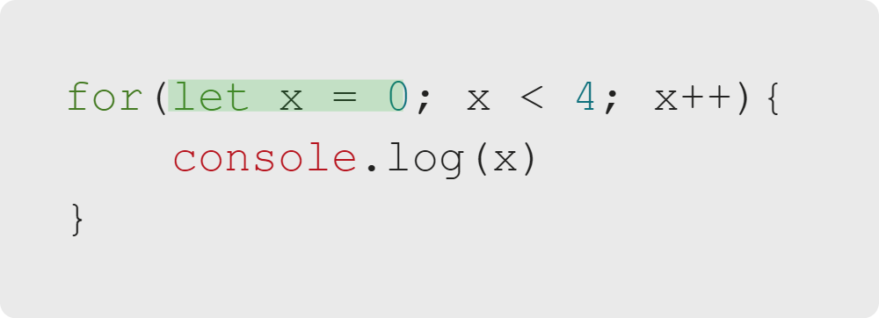
Arrays & Iteration
Initializer
Runs before the loop:
"This is where I want to start."
Notes:
Typically used to initialize a counter variable that will be used in the Condition.
This expression is often used to declare new variables with var or let keywords.
Variables declared with var are not local to the loop (can be accessed outside the loop).
Variables declared with let are local to the the loop (can only be accessed inside the loop).

Slide 9
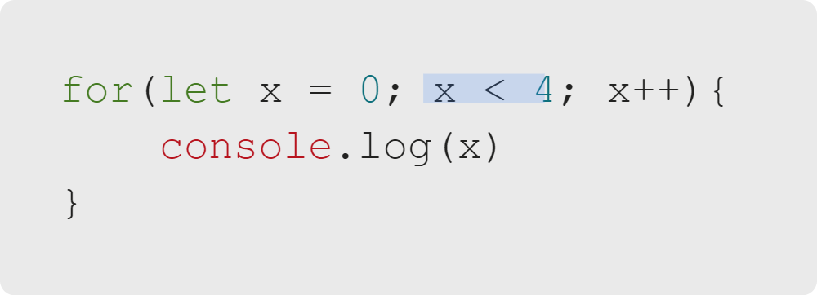
Arrays & Iteration
Condition
A Boolean expression that stops the loop when false:
"This is where I want to stop."
Notes:
This conditional expression is evaluated before each loop iteration.
If this expression evaluates to true, statement is executed.
If the expression evaluates to false, execution skips the for loop entirely (like an if statement).

Slide 10
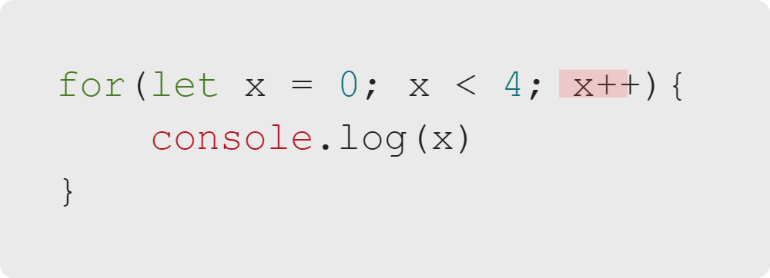
Arrays & Iteration
Afterthought
Runs at the end of each cycle of the loop:
"This is how I get from where I start to where I stop."
Notes:
This expression is evaluated at the end of each loop iteration.
This occurs before the next evaluation of the Condition (the second part).
Generally. the Afterthought is used to update or increment the counter variable
initialized in the Initializer (the first part)
<<Exercise 03--when does the Afterthought run?>>

Slide 11

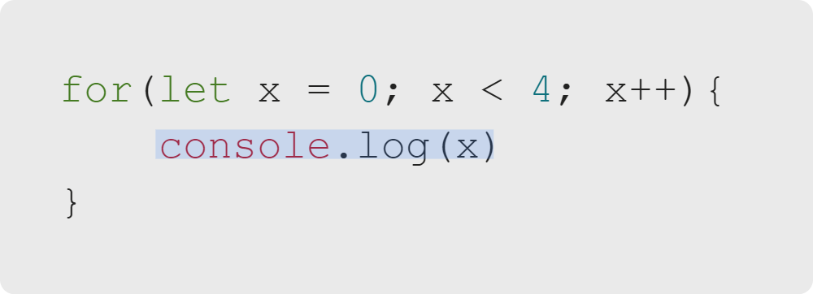
Arrays & Iteration
Body
The code to execute until the condition is false:
"This is the process I'm repeating."
Notes:
This is the code that gets run every loop cycle.

Slide 12
Arrays & Iteration
For Loop Example
Output:
Initializer
Condition
Afterthought
0
1
2
3
Notes:
We'll walk through an example in more detail in just a moment.
First, let's tie this back to our discussion of arrays.
<<Exercise 04--write a for loop (initialize x to 1, run while x < 10, increment x by 1)>>

Slide 13
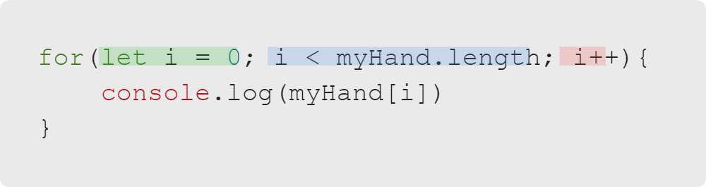
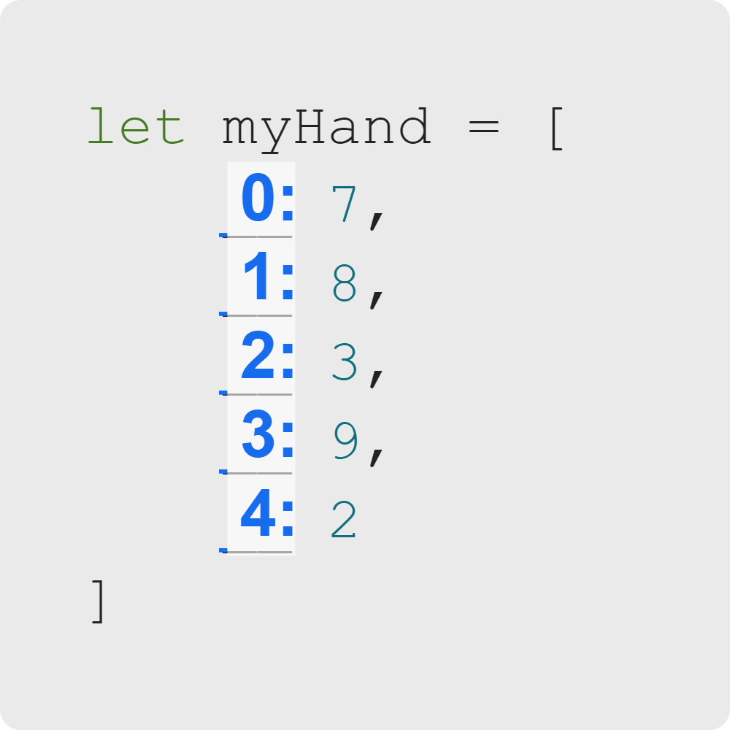
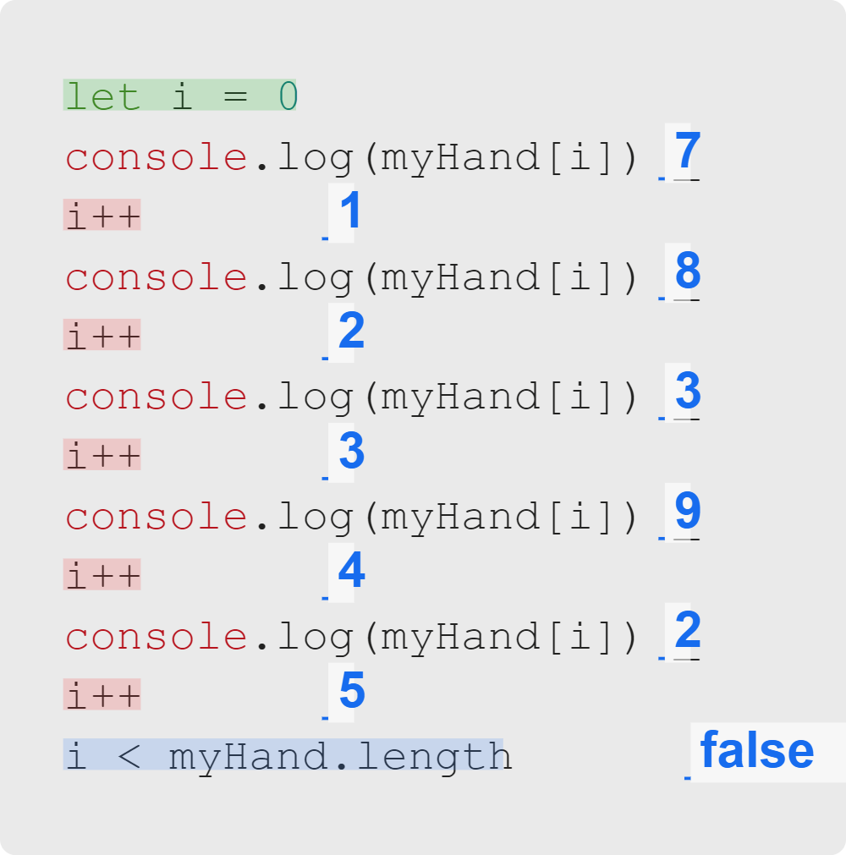
Arrays & Iteration
Iterating over an Array
Notes:
Using a for loop, we can repeatedly increase i to iterate over our array!
The code on the right will log each element in the array, *no matter how many there are!*
It does the same thing as the longer version below, but is easier and shorter to read.
By incrementing 'i', we can 'move' to the next element in an array.
We start at 0, go until i has reached the end of the array, and we get there by incrementing i.
<<Exercise 05--log each element in an array using a for loop>>

Slide 14
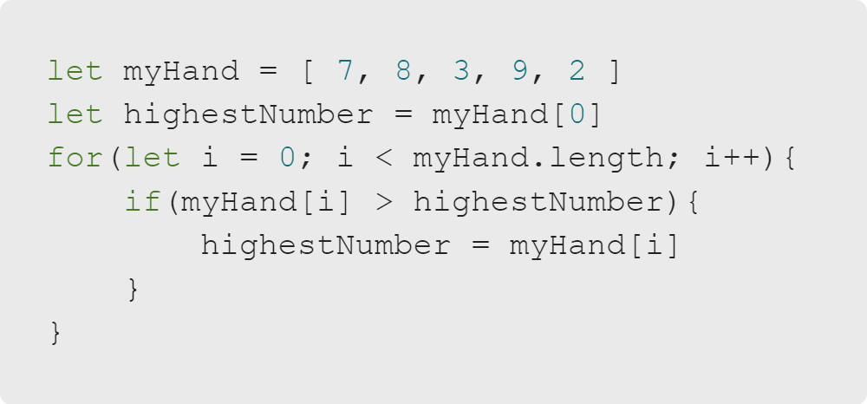
Arrays & Iteration
Example: Cards
What is the highest-numbered card in this hand?
Notes:
Using a for loop, we can teach a computer to find the highest-numbered card the way we did at the beginning of the lesson.
<<Exercise 06--iterate through an array using a for loop and add each item to a 'total' variable>>

Slide 15
Arrays & Iteration
Summary
What We've Covered:
Arrays & Iteration
Iteration
For Loops: Initializer, Condition, Afterthought, and Body
Accessing Array Elements
Iterating Over Arrays
Let's practice iteration with for loops.

